Slide 1

Parcel project
Emir Açikgöz
George Ottens
Ismail Böyükşimşek
Laurine van de Stolpe
Rick Hagenaar
Idriss Bensaga

Slide 2
Group members
Rick Hagenaar (software engineering)
Emir Açikgöz (Information security)
George Ottens ( aviation engineering)
Ismail Böyükşimşek (Information security)
Laurine van de Stolpe (Applied Mathematics )
Idriss Bensaga (Buisness and data Managment)

Slide 3
Content
Recap
What we did last week
Graphs of what we did
Some more graphs
The planning for this week
Questions

Slide 4
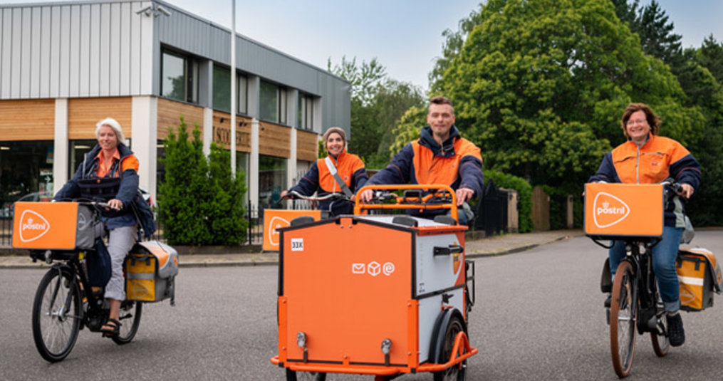
Recap
Product owner: PostNL (Tim Ottens)
Assignment: Predicting the amount of processed packages
Data: amount of daily packages processed, for 300 customers, for 5 years

Slide 5
What we did last week
Processed feedback
finished the preface of our paper
2 Different kinds of models:
Seasonal Autoregressive Integrated Moving Average
A simple neural network model

Slide 6
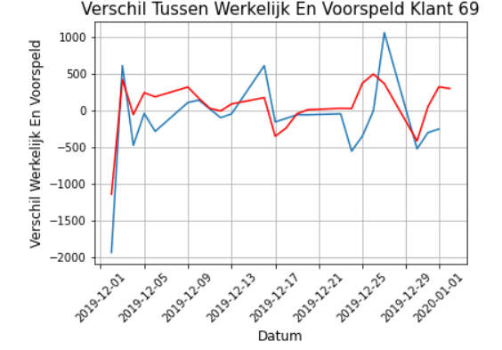
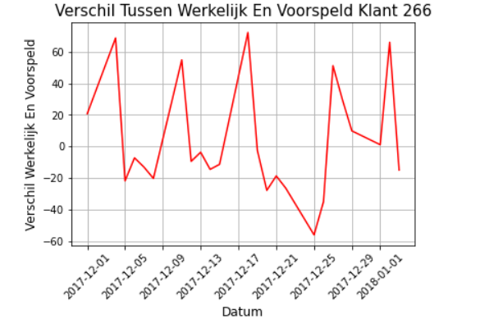
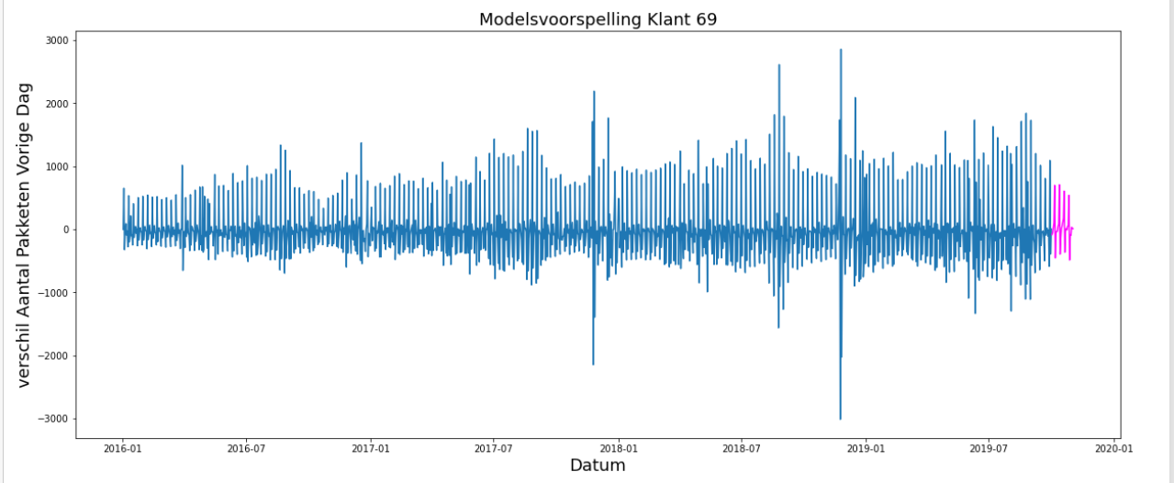
Graphs of what we did

Slide 7
The planning for this week
Paper
Neural Network
Progress with our personal portfolio

Slide 8

Questions

